Slide 1
NYC Public SCHOOLS: inflated graduation rates, but a low college readiness index
Michelle Cronin
GA - DAT30
Final Presentation DRAFT – March 7, 2016

Slide 2

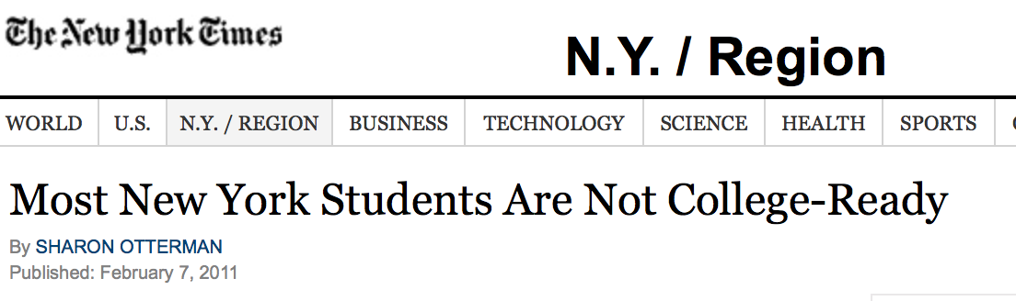
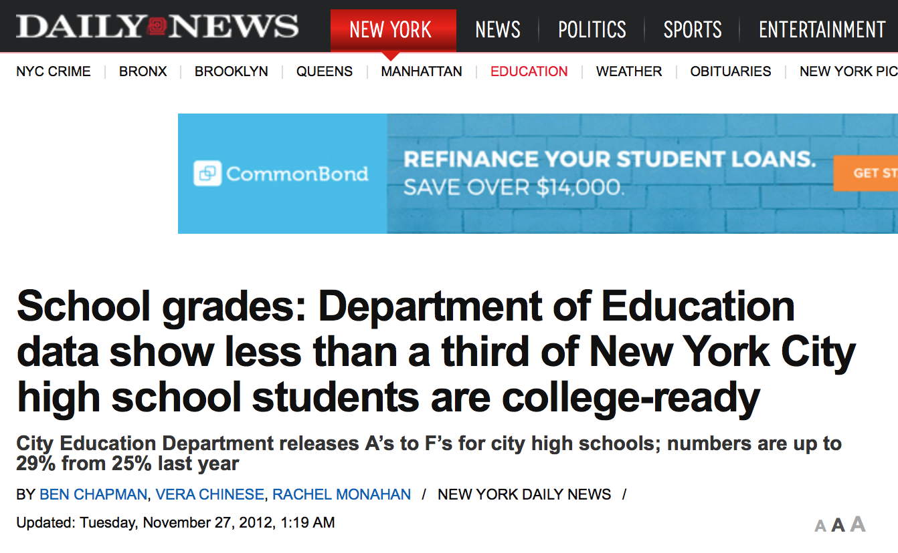
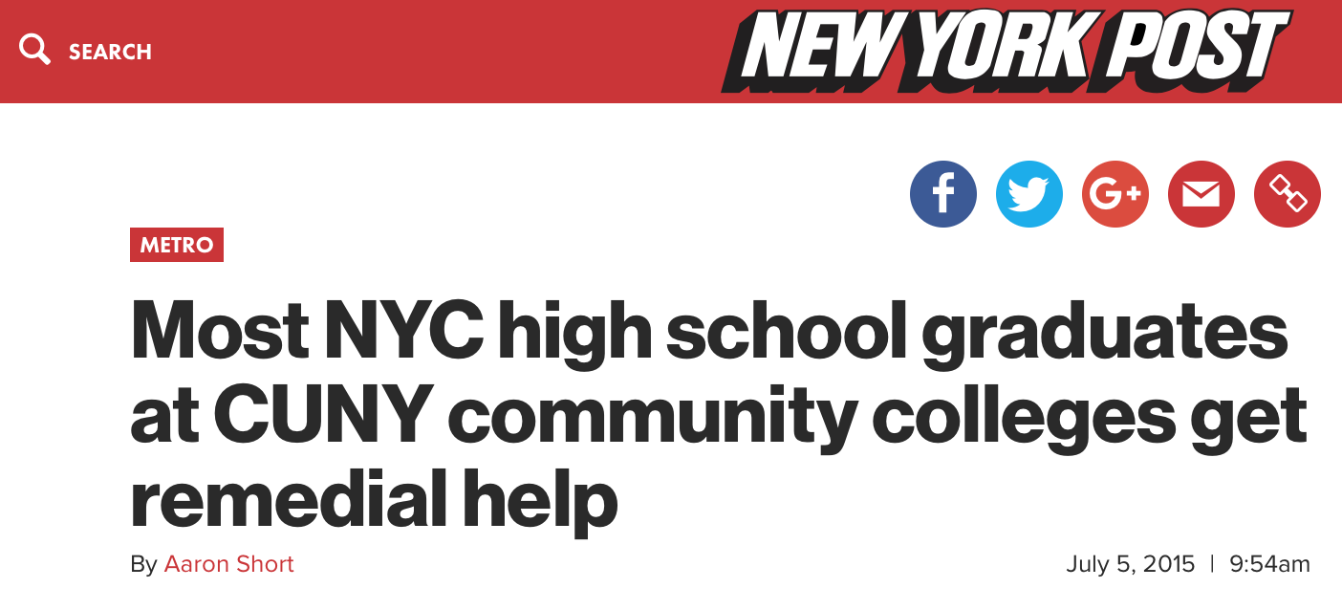
THE ISSUE
Although graduation rates in NYC public schools have risen over the years, the rate of students prepared for college has remained low (73% vs 29% on average, from my data)
Thus, NYC public schools are graduating many students each year who are not considered college-ready
Can we predict which schools are graduating college-ready students at a rate above NYC’s average graduation rate (within one standard deviation)? ← High-performing schools

Slide 3

Hypothesis
Major contributing factors may include:
Race/ethnicity of the student body
Poverty/wealth of the student body
Geographical locations of the schools/crime
Testing (test scores directly contribute to the college readiness index due to CUNY observations of remedial class rates)

Slide 4
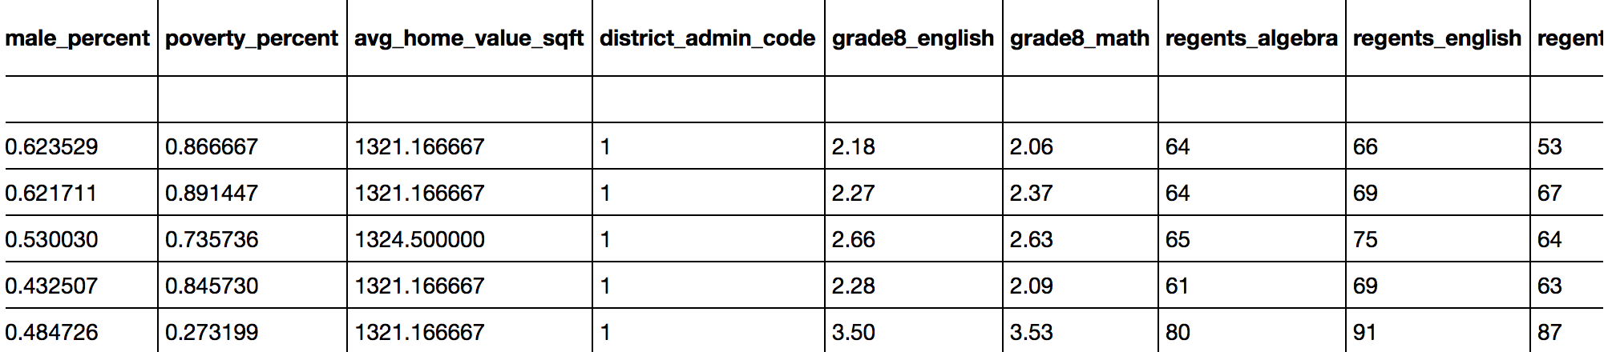
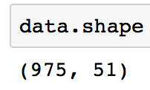
What data have I gathered, and how did I gather it?
Mostly measurable characteristics of NYC public high schools (performance, demographics, location, etc.) from NYC Open Data website and the NYC Department of Education website:
2013_2014_HS_SQR_Results_2015_03_02.xlsx
2014_2015_HS_SQR_Results_2016_01_07.xlsx
DemographicSnapshot201011to201415Public_FINAL-2.xlsx
2015 Graduation_Rates_Public_School-2.xlsx- DOE_High_School_Directory_2013-2014.csv
DOE_High_School_Directory_2014-2015.csv- 2014 Public Data File SUPPRESSED.xlsx
2015 Public Data File.xlsx- Location_Information_Report.csv
seven_major_felony_offenses_by_precinct_2000_2014.xls
violation-offenses-by-precinct_2000-2014.xls
Zip_MedianValuePerSqft_AllHomes.csv

Slide 5

Pre-processing
Dropped and imputed missing values
Feature Selection – Necessary due to overlapping features in sources as well as presence of irrelevant features
Feature Engineering:
Length of School Day (End of day – Start of day)
Diversity Score (Sum of the squared reported race/ethnicity percents [black, white, Hispanic, Asian])
Overall SAT score (Reading SAT + Writing SAT + Math SAT average scores)
Overall Regents score (Algebra + English + Living Environment + Global History Regents average scores)
Grade 8 Proficiency score (Grade 8 Math + Grade 8 English scores)
All Crime (Major crimes + violation offenses)
Tidied the names
Dummy categorization (Zip codes and Administrative districts, separately)

Slide 6
Feature Selection
Created visuals to look at correlation (heatmap) → Removed highly correlated features (ex: many Regents exams)
Created visuals to view missing values → Removed those missing 50%+ (ex: pupil-teacher-ratio)
Viewed feature variance → removed those with lowest variance (ex: Public Service percentage attendance)
In the end, removed features directly related to the response variable to see how well other features would fare
Graduation Rate
College-Readiness Index (CRI)
Test scores related to the CRI: average SAT scores, Regents values, percentage of students scoring 3+ on AP exam
Ran models on four different datasets:
One with test scores (only for comparison)
One without test scores
One with administrative district codes (also without test scores)
One with zip codes (also without test scores)

Slide 7

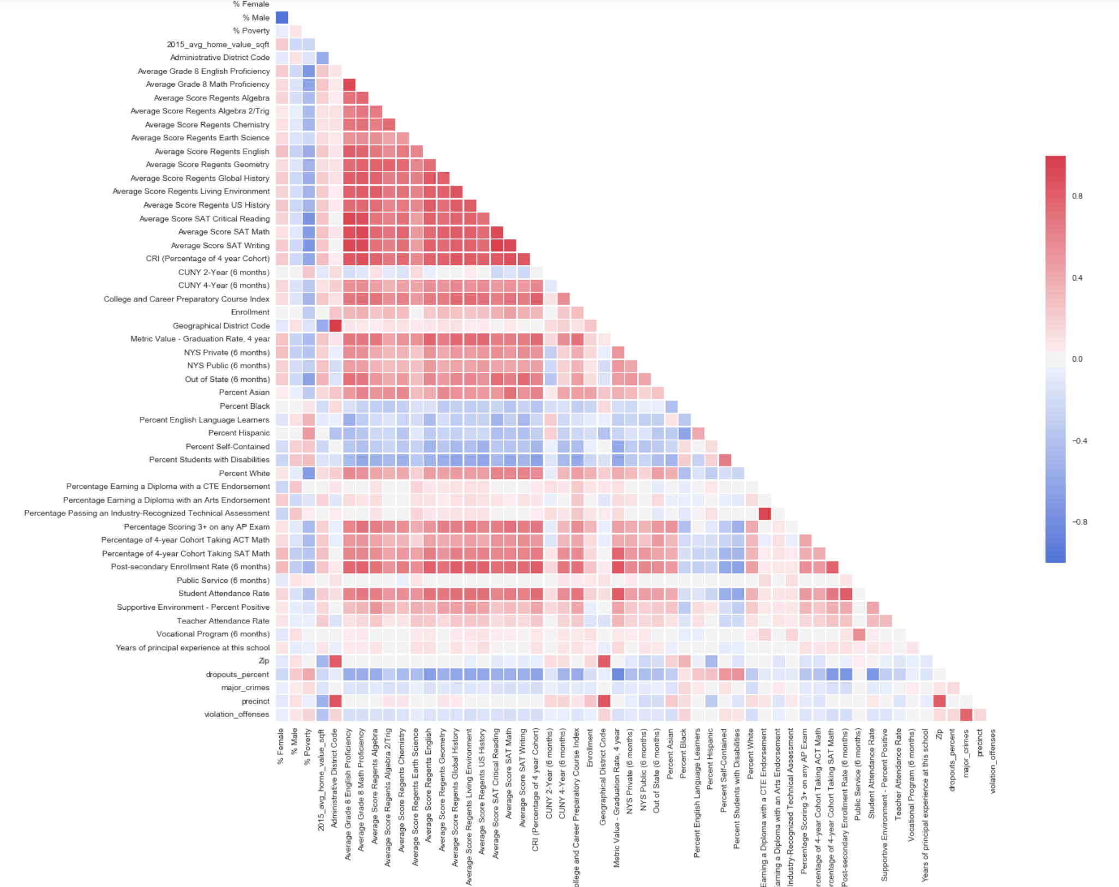
What insights have I gained from My exploration?
High school’s graduation rate and college readiness index share high correlation with the following features (in varying strengths):
Post-Secondary enrollment rate
Student Attendance Rate
Percentage of students who take the SAT
Overall Regents score
Grade 8 Proficiency Scores
Poverty and Disability (Negatively correlated)

Slide 8
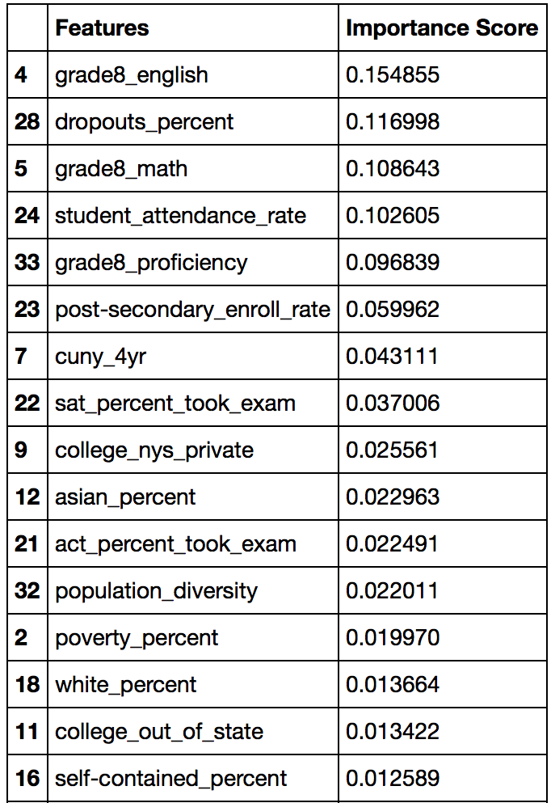
MODELING
Minimum Benchmark: 87%
Random Forest
Protect against overfitting (great because I have a considerable amount of features)
Will tell me most important features (which I can feed into other models)
Using accuracy to validate the models, they all beat the benchmark at ~95%
Using F1, only model with zip codes does (barely at 88%)
Logistic Regression
Lasso/ridge will drop/let me know unimportant features
Will allow me to view feature coefficients
k-means Clustering:
I may be able to discover distinguishable groups of schools to find some counterintuitive combinations of characteristics as well as obvious ones

Slide 9
CHALLENGES/SUCCESSES
CHALLENGES:
Putting together different datasets into one ate up tons of time, including endlessly searching for additional datasets for information I was lacking but felt could be valuable
I have so many features that even my shortest dataset feature-wise wouldn’t run Logistic Regression or SVM on it
Issue with k-means with inverse_transform to view cluster centers; somehow a different size than it should be??
SUCCESSES:
Interesting takeaways, some supporting hypothesis but some new perspectives too
Despite highly unbalanced class, models performed better than I expected

Slide 10

Conclusions
Grade 8 Proficiency importance
FUTURE STEPS:
Complete similar work but in middle/elementary schools
Longitudal view of the data as more data is released with each schoolyear; track progress

